Slide 1
Blockchain and IoT for Delivery Assurance on Supply Chain (BIDAS)
A structured framework to reach to a blockchain solution that help provide delivery assurance
Mehmet Demir, Ozgur Turetken, Alex Ferworn

Slide 2
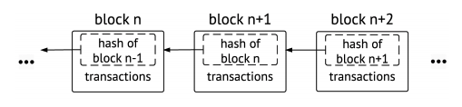
Blockchain subject is interesting since
+The blockchain technology is (still) new and exciting
+Cryptocurrencies are spectacular
+Distributed applications (Dapp) are different.
+Every bit of implementation is sensitive and important
+Almost every implementation is ground breaking
-The subject is new. There is not enough data.
-Limited analysis yet. Findings of the existing studies are limited.
Notes:
+The blockchain technology is (still) new and exciting
+Cryptocurrencies are spectacular
+Distributed applications (Dapp) are different.
+Every bit of implementation is sensitive and important. Risk is high. Attackers have high motivation.
+Almost every implementation is ground breaking
-The subject is new. There is not enough data.
-Limited analysis yet. Findings of the existing studies are limited.

Slide 3
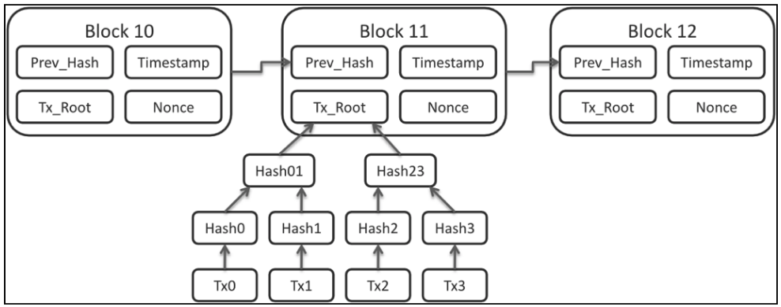
Our subject is interesting since
+Cryptocurrencies are well discussed
+Conversations start with blockchain and end with cryptocurrencies
+Blockchain ideas need frameworks to evaluate, design, implement and test
+There are specific use cases like IBM and Maersk having a shipping blockchain
-no study providing a general framework for delivery assurance
-general impression we see is that blockchain seems like a big implementation on standard use cases.
We want to show it can be adopted by smaller scopes

Slide 4
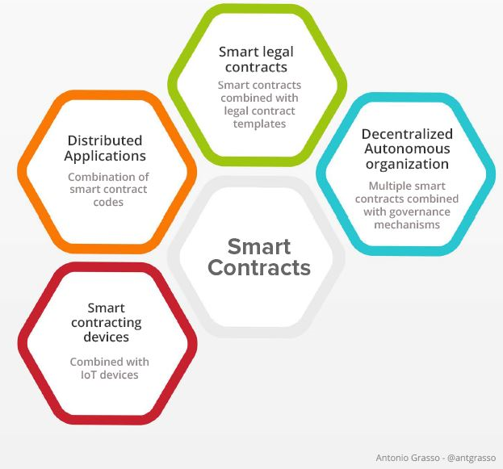
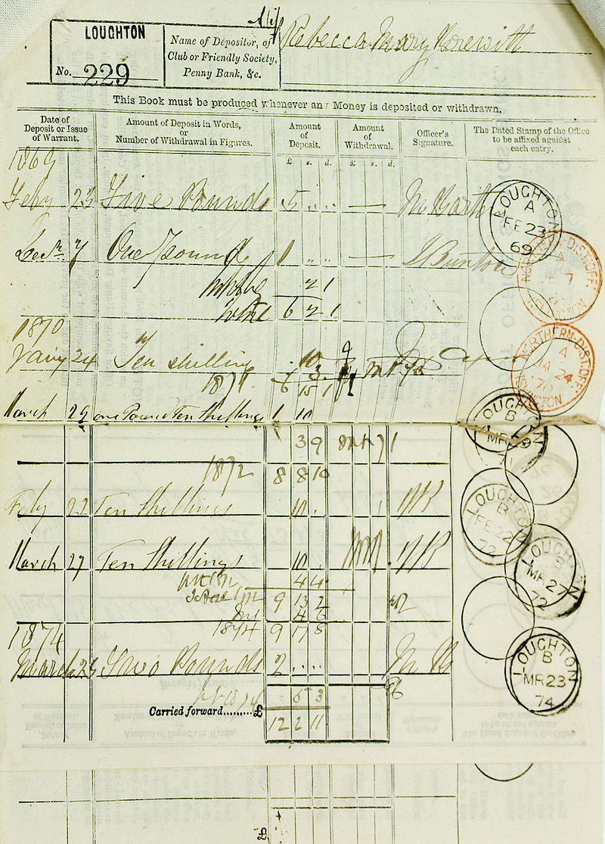
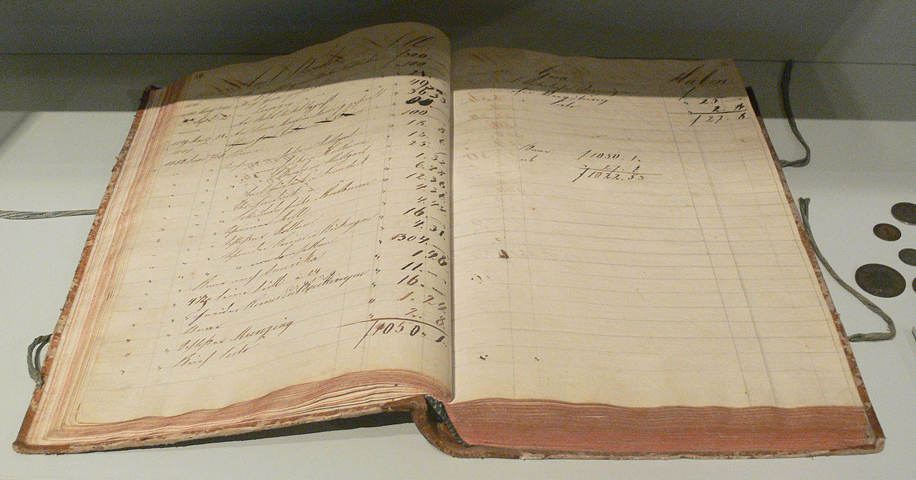
Blockchain and Smart Contracts
Record keeping has been a factor to facilitate cooperation between people in large groups and eventually contributed to the formation of large-scale societies
https://evolution-institute.org/the-role-of-writing-and-recordkeeping-in-the-cultural-evolution-of-human-co/.

Slide 5
Delivery Assurance
Traditional
RFID tags
Barcode Scanners
Manual labor
Somehow appear at the destination
Last mile costing around 30% of the delivery
New realities
Competition - Crowd
New trajectories (UAV delivery)
New interactions (Autonomous land vehicles)

Slide 6
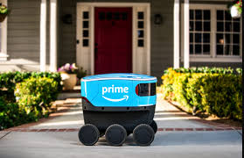
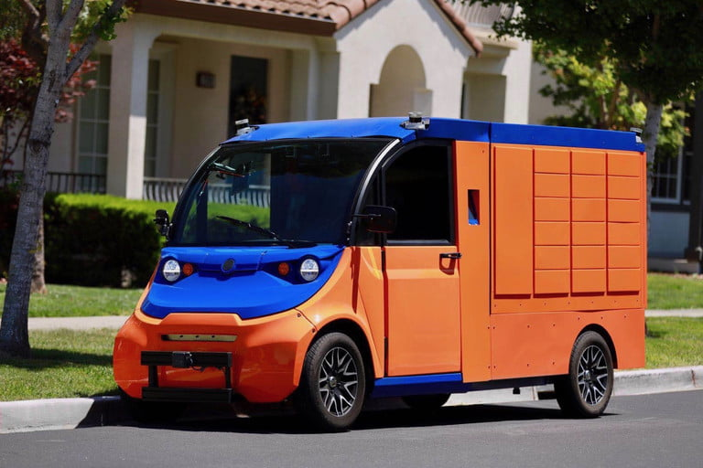
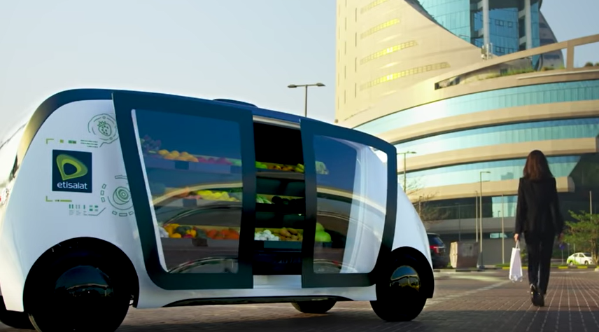
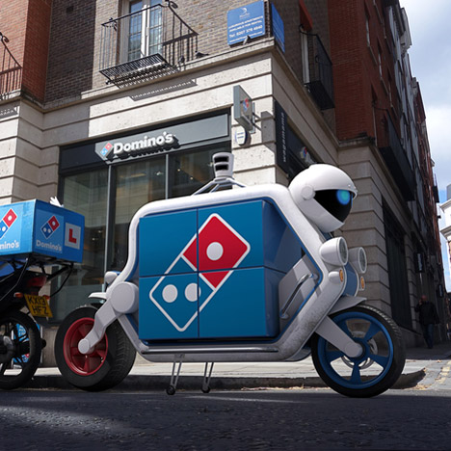
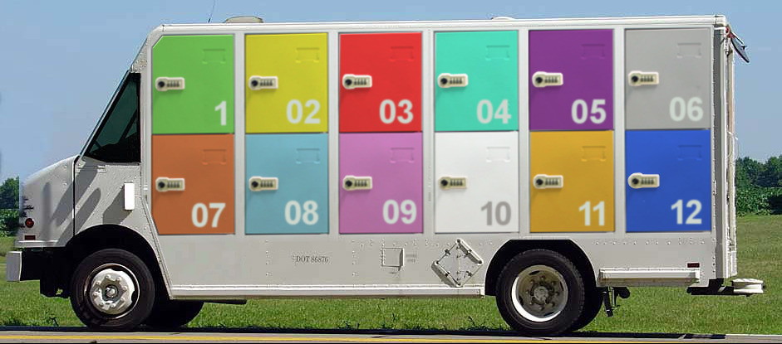
Autonomous delivery vehicles
https://www.digitaltrends.com/cars/boxbot-self-driving-autonomous-electric-delivery-vehicle/
https://spectrum.ieee.org/cars-that-think/transportation/self-driving/nuro-raises-92-million-for-adorable-autonomous-delivery-vehicles
https://cleantechnica.com/2019/01/27/amazon-scout-enters-the-autonomous-delivery-market-several-others-currently-being-tested/
https://www.dezeen.com/2015/04/01/dominos-launches-worlds-first-driverless-pizza-delivery-vehicles/
https://sqwabb.wordpress.com/2016/03/10/self-driving-cargo-i-can-see-it-all-now/
Robomart.co

Slide 7
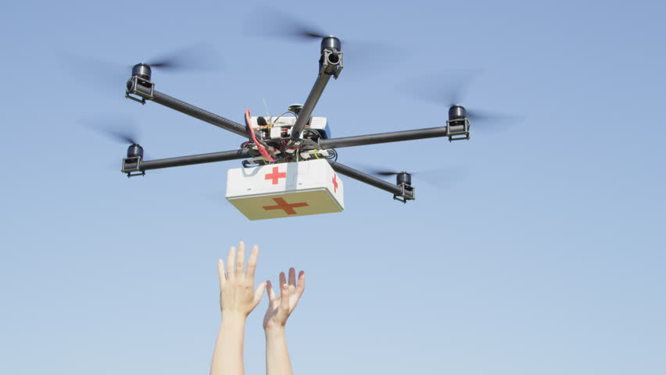
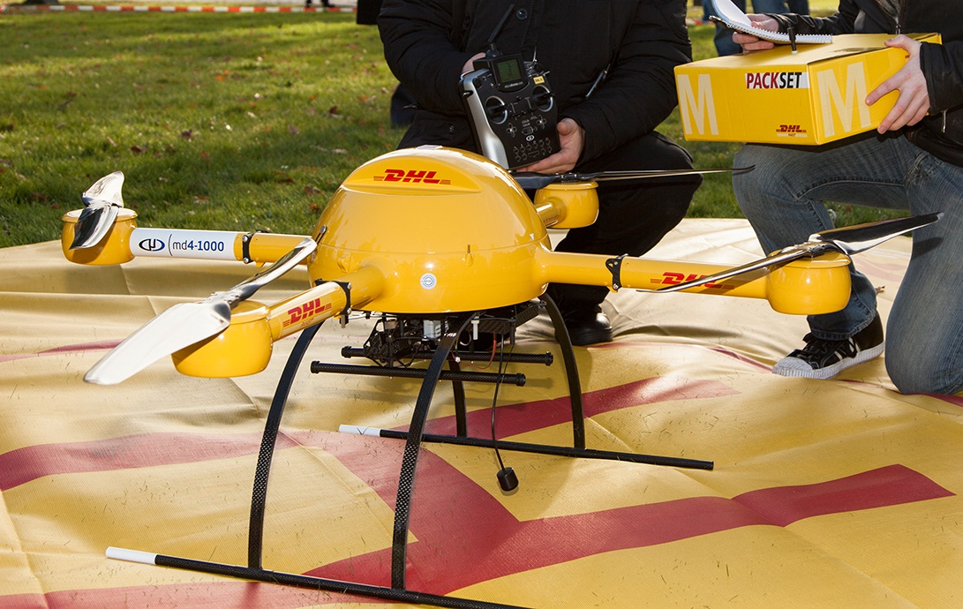
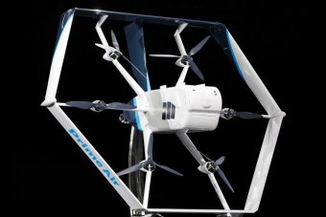
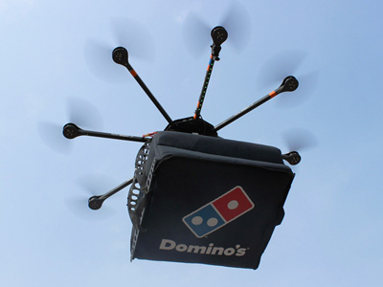
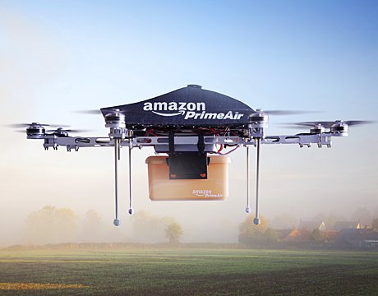
Autonomous delivery - UAV
https://www.wetalkuav.com/drone-based-medicine-delivery-coming-north-carolina/
https://en.wikipedia.org/wiki/Delivery_drone#/media/File:Package_copter_microdrones_dhl.jpg
https://www.abc.net.au/news/2019-06-06/amazon-announces-shopping-delivery-drones-stylesnap/11186024
https://dronelife.com/2017/06/08/privatizing-air-traffic-control-actually-help-drone-delivery/
https://www.dronethusiast.com/drone-delivery-plans-hindered-new-faa-proposed-rules/

Slide 8
Mobile IoT and Blockchain
5G technology is expected to enhance IoT connectivity and keep a continuous connection and transfer data streams to the network [Drones].
Mobile IoT devices will benefit more from blockchain technology. inter-vehicle communication [NTMS], vehicle forensics, and insurance.
There are several infeasible or incomplete implementations due to lack of understanding including some blockchain and drone integration. [AERO token]
[Drones] https://www.bbc.com/news/business-43906846
[NTMS] 2018 9th IFIP International Conference on New Technologies, Mobility and Security (NTMS) “Efficient Distributed Admission and Revocation using Blockchain for Cooperative ITS”
[AERO Token] https://hackernoon.com/aero-token-enabling-the-drone-superhighway-using-the-blockchain-ce2cf5004a10

Slide 9
How to model the delivery business – new fundamentals
Chain of custody throughout the handover of packages
+
CMS: Condition monitoring systems are reliability agents that are created from collections of electronic sensors that monitor a variety of environmental conditions related to an asset.
Vibrations
Acceleration
Temperature
Humidity
Acoustics
Global Positioning

Slide 10
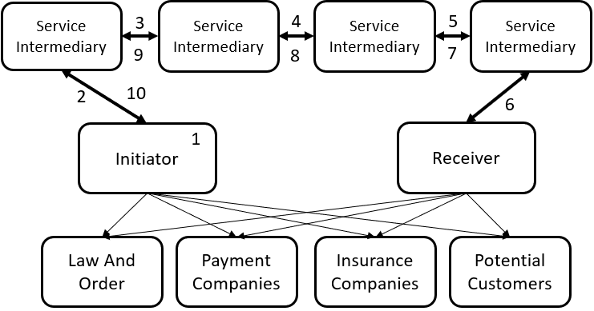
Information flow from delivery initiation to completion

Slide 11
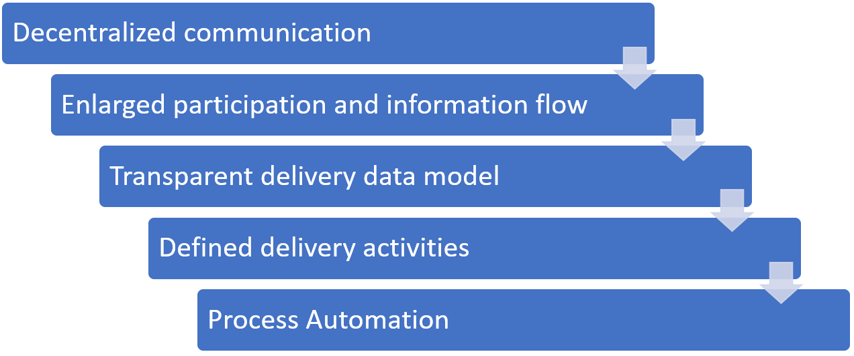
BIDAS Framework recommended steps for delivery assurance

Slide 12
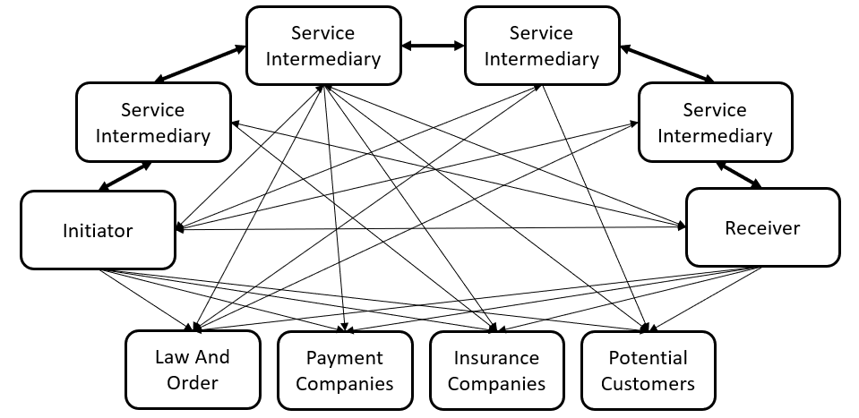
BIDAS Decentralized communication

Slide 13
Roles in delivery
Party Type | Initiator | Service Intermediary | Receiver
Principal | Initiator | Service Intermediary | Receiver
Actor/Agent | Initiator Actor/Agent | Service Intermediary Actor/Agent | Receiver Actor/Agent
Sensor | Initiator Sensor | Service Intermediary Sensor | Receiver’s Sensor
Sensor Host | Initiator Sensor Host | Service Intermediary Sensor Host | Receiver’s Sensor Host

Slide 14
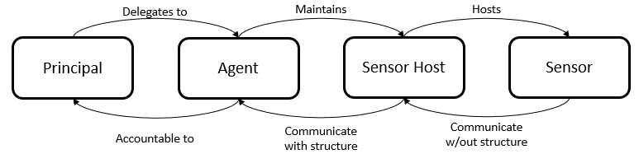
Principal-Agent-Sensor Host-Sensor model of BIDAS

Slide 15
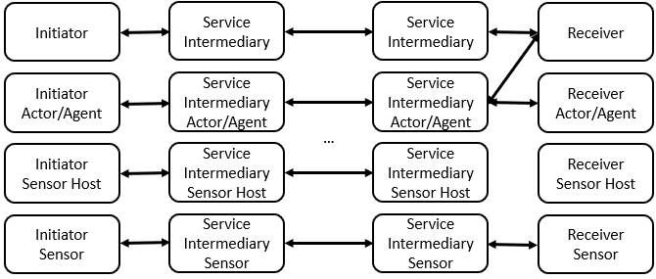
The BIDAS business interactions model

Slide 16
List of Primary Entities
Entity Name | Attributes
Receiver | Id, Status, Contact Details, Delivery Destination Details, Coordinates
Supplier | Id, Contact Details, Shipment Contact Details, Customer Service Contact Details,
Order | Id, Order Items, Receiver
Order Item | Id, Amount, Price, Tax
Payment | Id, Amount, Method, Details (Number, Expiration, security Code, Reference Number), Timestamp
Invoice | Id, Total Price, Tax
Deliverable | Id, Packaging Type, Dimensions, Weight, Order Items
Delivery | Id, ETA, Tracking ID, Deliverable
Delivery Stage | Delivery State and Status
Delivery Event | Receiver, Receiver Agent, Receiver Sensor Host, Receiver Sensor, Contact Event
Delivery Schedule | Delivery, Time Period, Date
Contact Event | Image, Signature
Agents (Employees) | Agent Id, Title, Salutation, Given Name, Family Name, Gender, Birth Date, Contact Details
Sensor Hosts | Id, Receiver, Sensors, Contact Details, Serial Number
Sensors | RFID, UID, Serial Number
Sensor Event | Sensor, Latitude, Longitude, Altitude, Latitude Direction, Longitude direction, Altitude direction, Temperature, Pressure, Acceleration, Noise

Slide 17
List of Activities
Activity Name | Description
Registration | For each actor, a registration is needed to be for identification in the system
Create Order | Initiator creates an entity for delivery, order, set the status to order received
Delivery Status Change | Participants update the status of delivery such as shipped.
Observation Recorded | Sensors or sensor hosts records device readings and observations
Handover | Participants indicate that the package has changed hands
Return Delivery Item | Receiver or initiator changes the destination back to the return destination for the order
Cancel Delivery | Receiver or initiator changes the destination to the cancel destination for the order
Complete Delivery | Service provider of the last mile marks the delivery as complete.
Received Delivery | Receiver marks the delivery as received
Opinions Recorded | Parties record their opinions related to the delivery

Slide 18
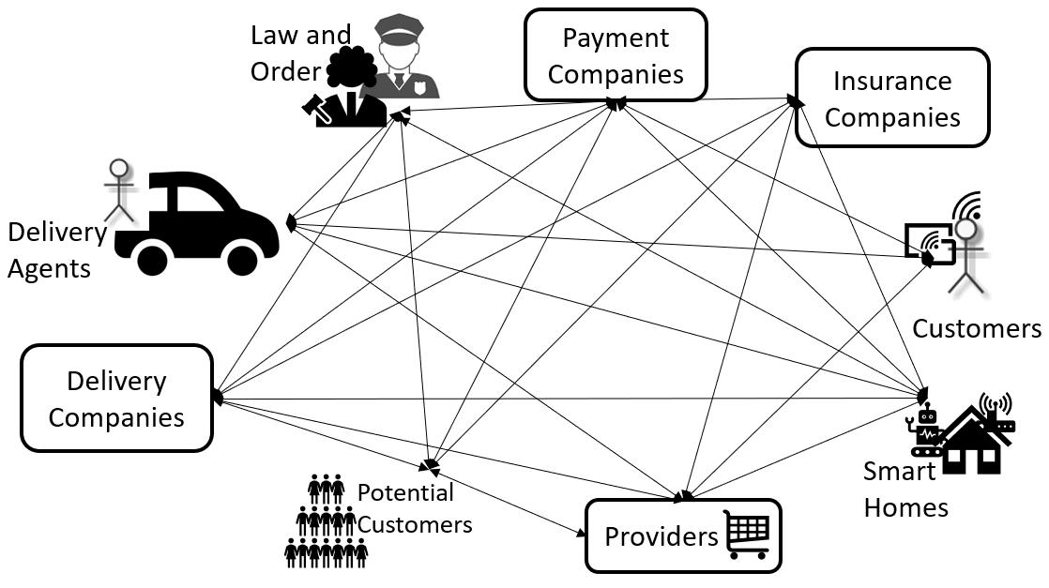
Use Case : Ecommerce delivery

Slide 19
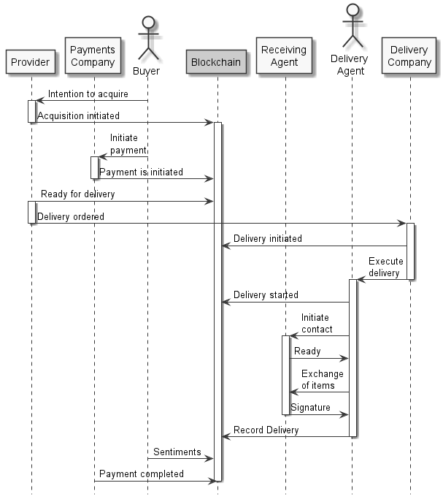
Sequence of Flow

Slide 20
Questions?
Contact: Mehmet.Demir@Ryerson.ca

